Slide 1

Telco Customer Churn
Data Analytics Project
Presented by: Maithreyee B Bharadwaj
Email- maithreyee95@gmail.com
Date :

Slide 2
Problem Statement
I am a data analyst working for a telco company named FastInternet which provides internet and phone services. My manager has asked me to give a detailed report on why customers have left our company for the quarter Q3. My job is to use data to find out the reasons to why customers are leaving and give recommendations on how to reduce the customer churn.

Slide 3
What is Customer Churn
Customer Churn is the percentage of customers who have stopped purchasing your business products or services during a certain period.

Slide 4
Exploring the Database
Exploration of the database was split into two parts:-
Analysing the Database
Visualizations

Slide 5
Analysis of the database
The database consists of 5 tables
Tables | Rows | Columns
CustomerDemographics | 7043 | 9
CustomerLocation | 7043 | 9
CustomerPopulation | 1671 | 3
CustomerServices | 7043 | 31
CustomerStatus | 7043 | 12

Slide 6
Visualizations
The visualizations that will be presented today will be related to the various reasons as to why customer churn is happening.
Certain visualizations are related to our company’s products and services
While the rest are related to customer demographics and the locations they reside in.

Slide 7
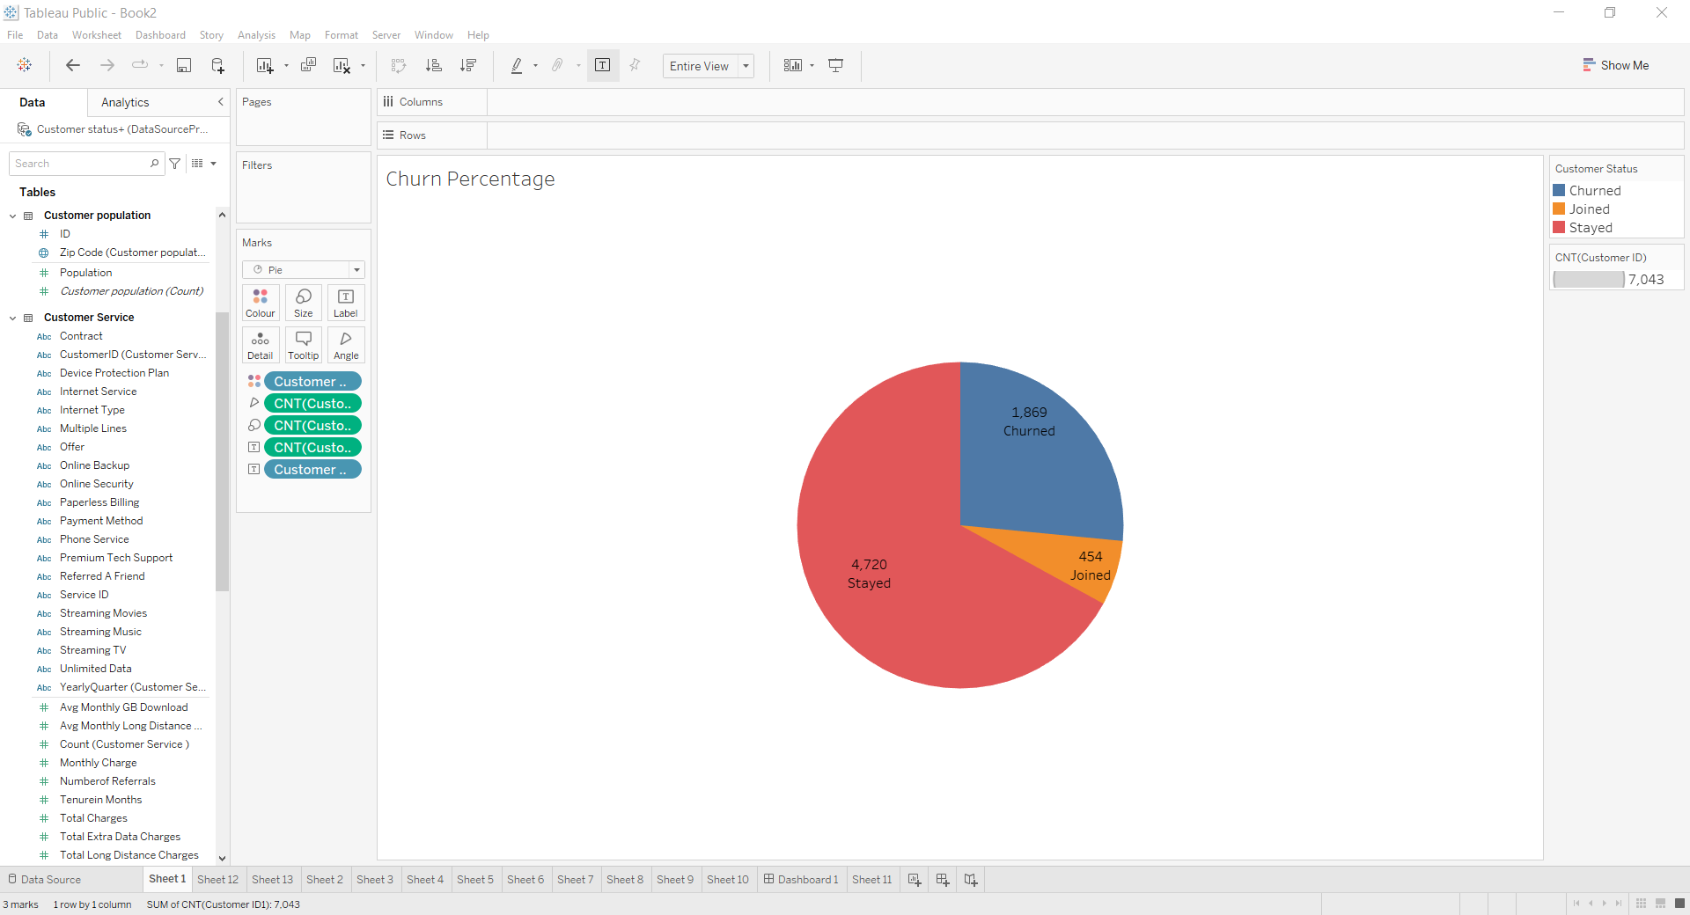
Percentage of Churn
The visualization represents the percentage of how many customers have churned, stayed and joined out company in the Quarter Q3.
It can be observed that out of 7043 customers in our company, 1869 customers have churned for the Quarter Q3
26.54 % customers have churned in the quarter Q3.

Slide 8
Reasons for Churn
Analyses of the database revealed certain patterns and trends for customer churn. The reason are listed below:
1.Contract
2. Region
3. Age
3. Customer Satisfaction Score of Churned Customers
4.Internet Type
5.Online Security
6.Tenure in Months
7. Internet Service
8.Phone Service

Slide 9
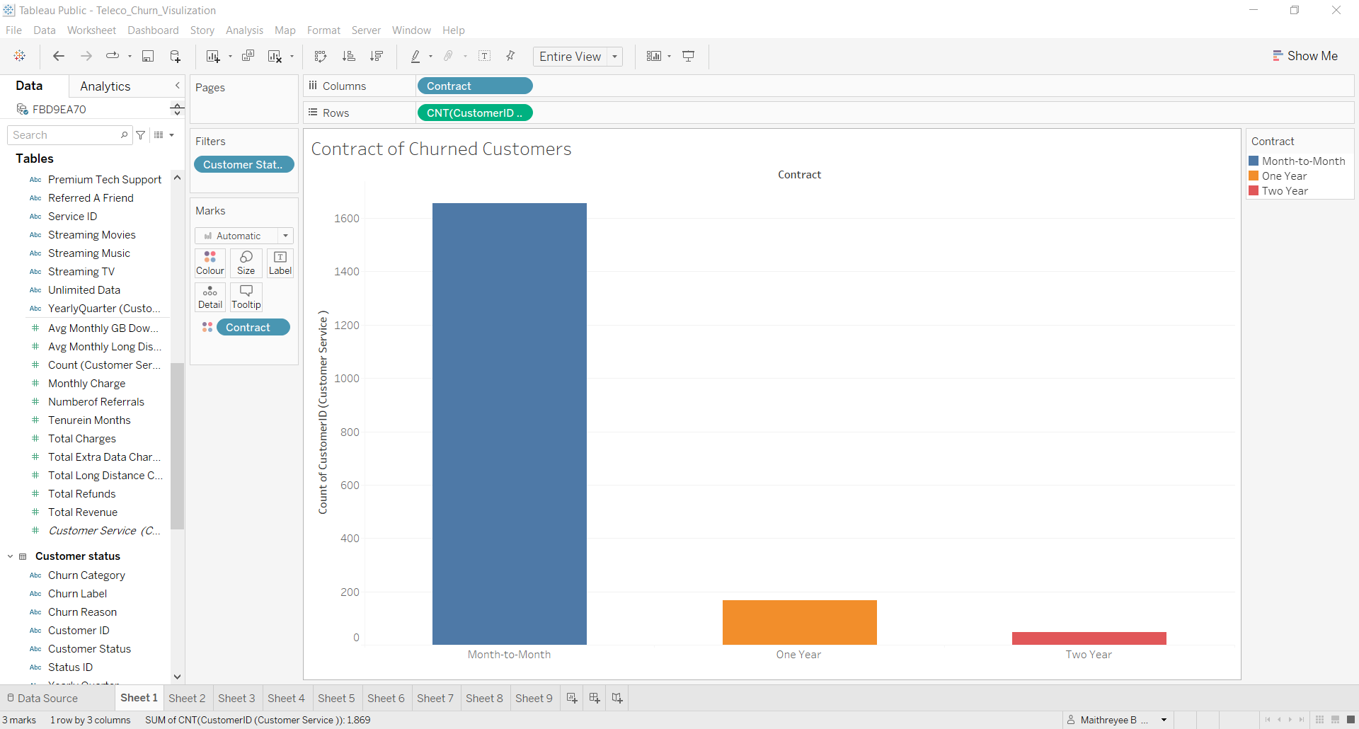
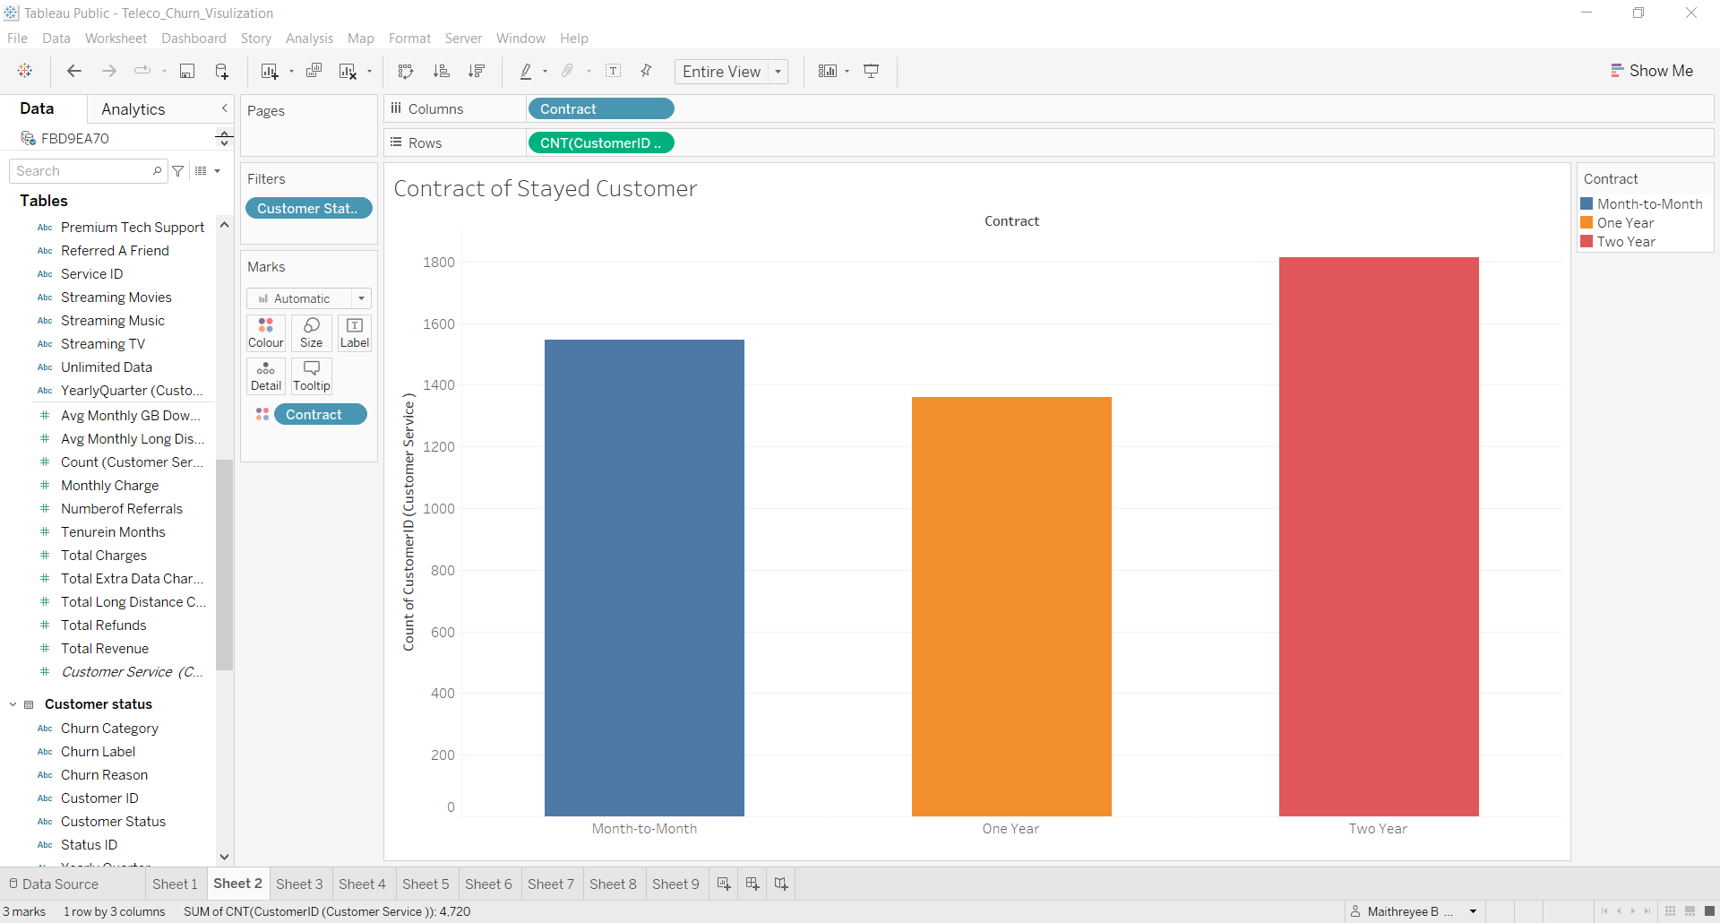
1. Contract
There is trend that customers who have churned were more likely to be on a Month-to-Month contract.
It can be implied that there is some relation between contract and the churn.
Is it easier to break the monthly contract ?
Contract Of Churned Customers
Contract Of Stayed Customers

Slide 10
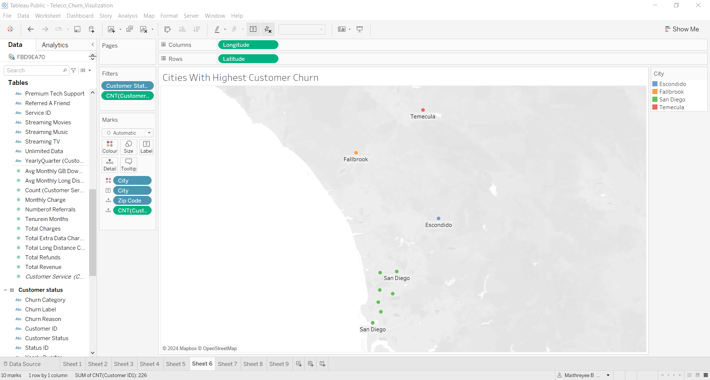
Region
It can be clearly observed from the visualization, that these are the top ten Zip Codes that clearly present the highest churn.
All these Zip Codes are clustered in southern California in the San Diego area.
Further analysis showed that most of the customers gave the churn reason to be competitor made a better offer.
This implies that a new competitor has moved into the area

Slide 11
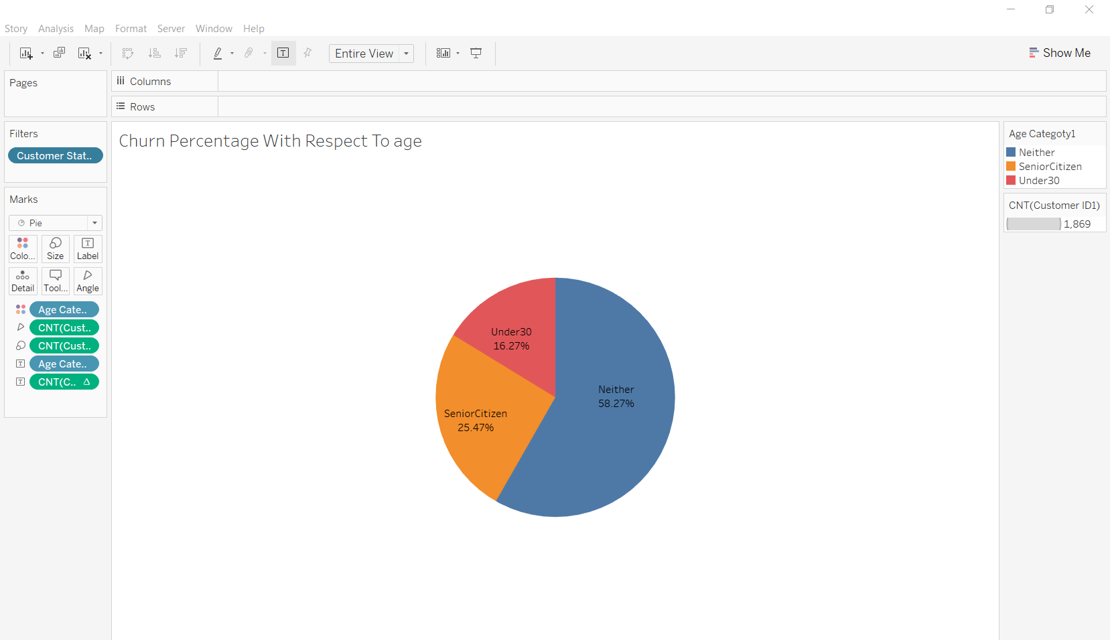
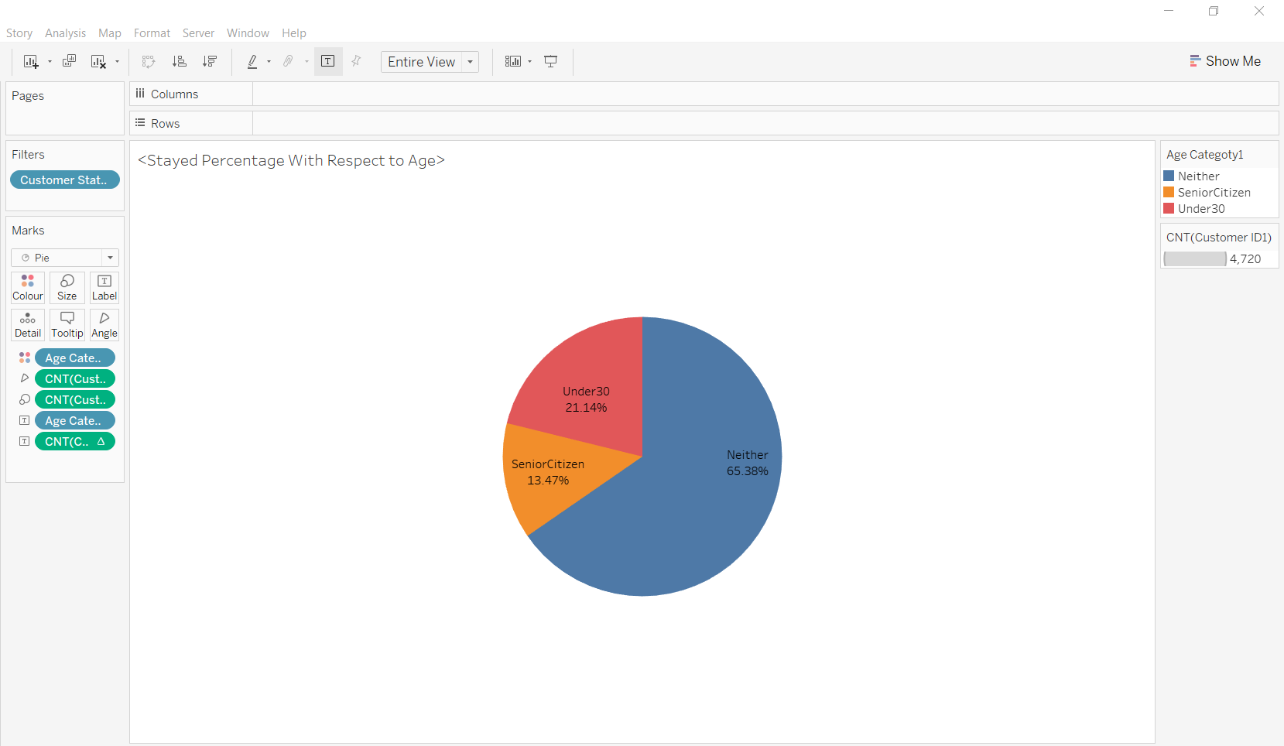
Churn Percentage with Respect to Age
The customers are divided into three age categories which is Under 30,Neither and Senior Citizen
The percentage of Senior Citizens who have churned is more the ones who have stayed by 12%.
Churned
Churn percentage with respect to age
Stayed
Percentage of customers who have stayed with respect to age.

Slide 12
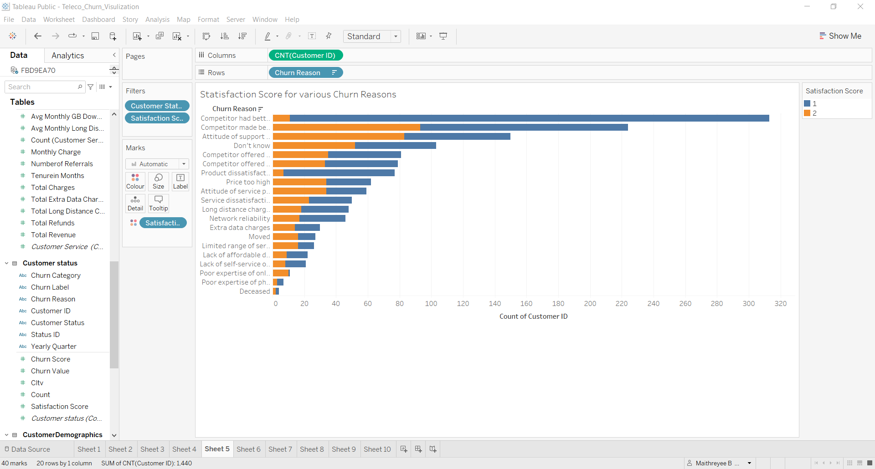
Satisfaction Score of Churned Customer
The satisfaction score of churned are between 1 and 2.
It can be observed that most number of customers who have given the satisfaction score as 1 the major reasons are :
1.Competitor offered better devices
2. Product dissatisfaction
This implies that our company modems are an issue.
Customers who have given a satisfaction score 2 the major reasons for churn are:
1. Competitor offered better devices
2. Attitude of the support person
This can imply that our customer service personal are not treating our customers well.

Slide 13
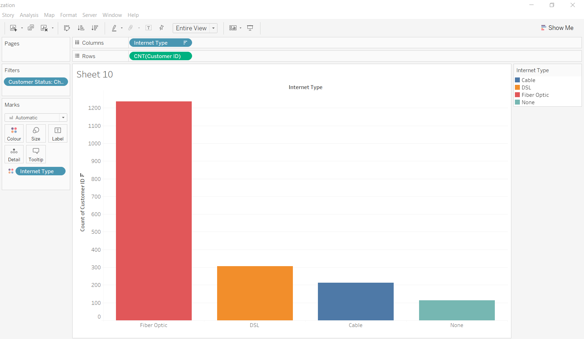
Internet Type
Fiber Optics has the highest customer churn.
Over 1200 customers alone have churned who have chose Fiber Optic as their internet type
This implies that customers as not happy with our Fiber Optics service
Further analysis shows that average GB used for download by customers using Fiber optics is 22.81.
This is less compared to DSL whose average GB used for download is 26.52 for just 213 customers.
Notes:
About 66.36% of customers who have opted Fiber optic have churned

Slide 14
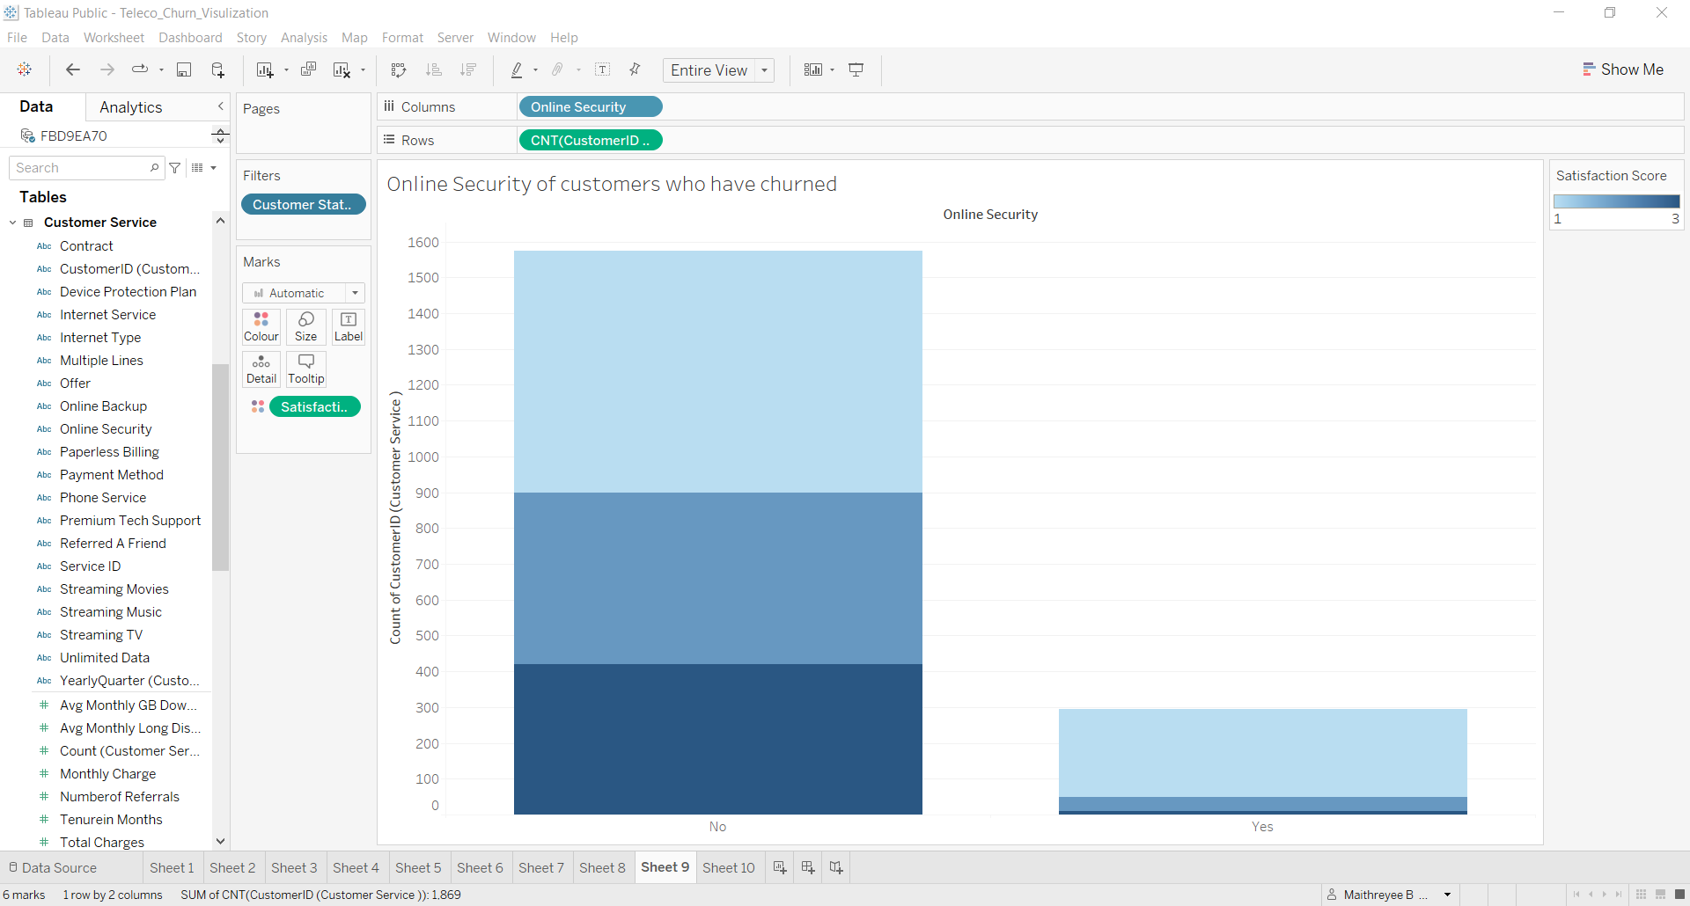
Online Security
Churned Customers
Satisfaction score of customers who have churned and have subscribed to the service online security service have rated the service ranging from 1-3.
This implies that the company’s online security products or options were not up to the mark.

Slide 15
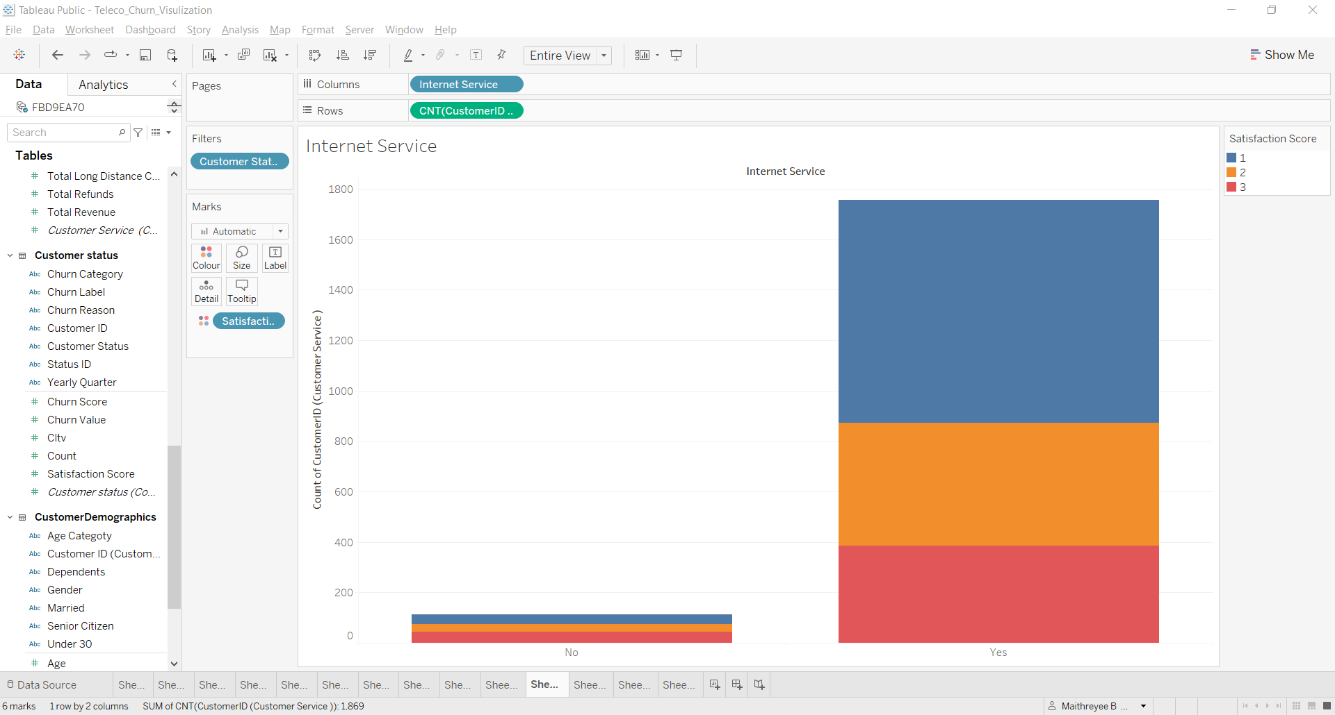
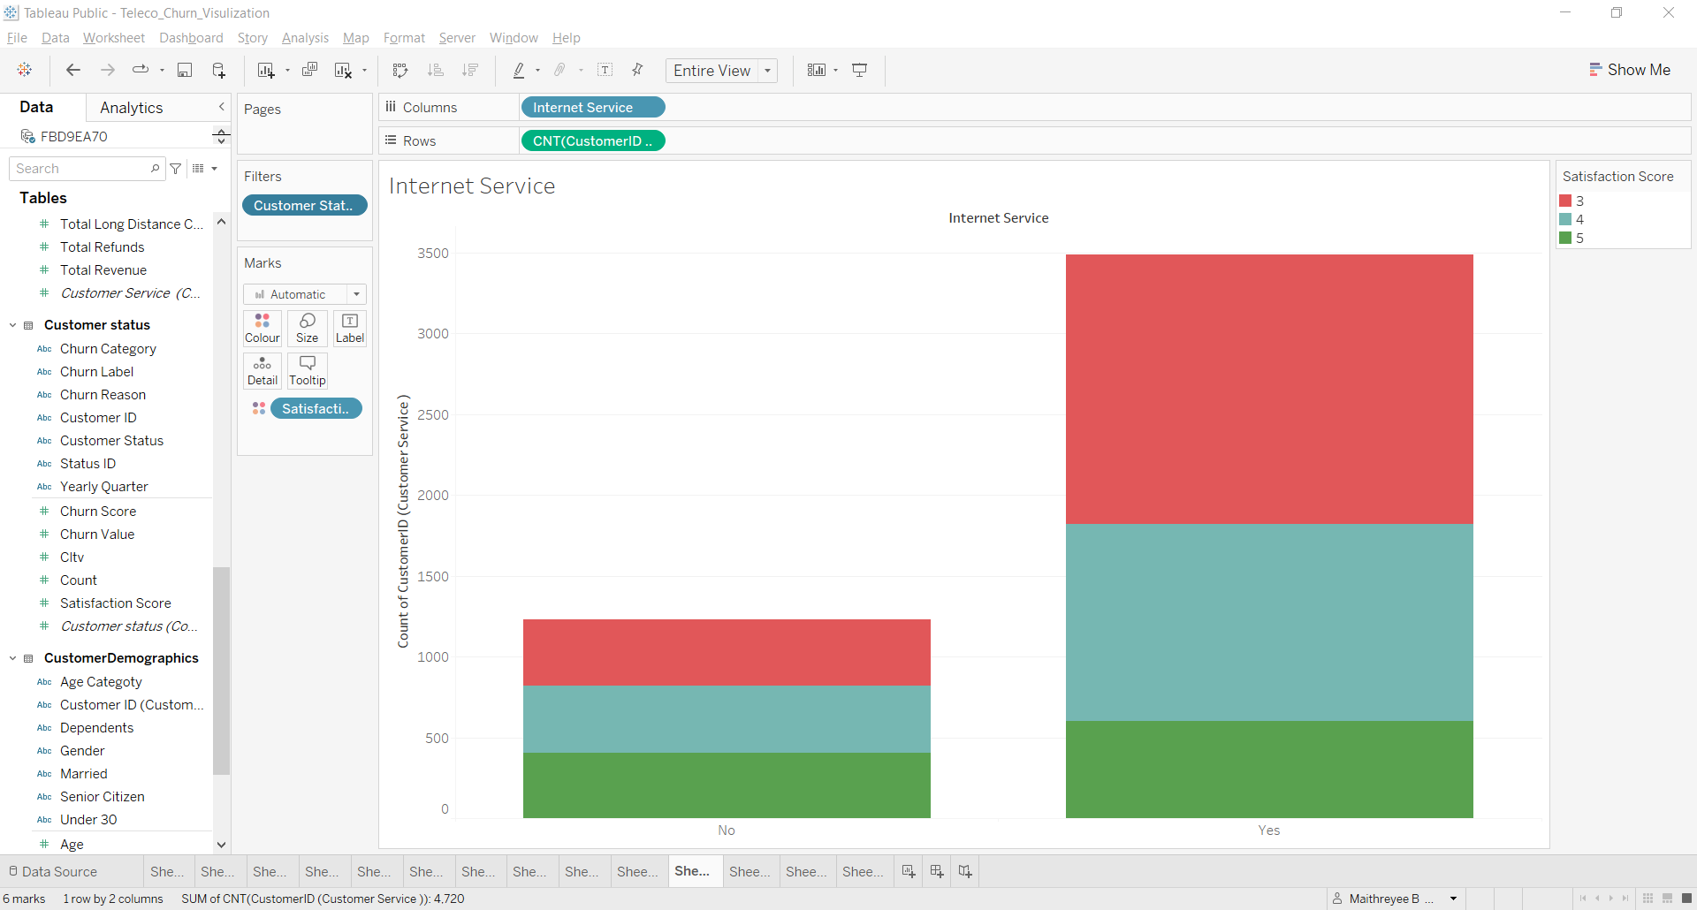
Internet Service
Majority of the churned customers had subscribed to the internet service
The satisfaction score for internet service is from 1 to 3.
A deeper analysis provided insights to the reasons of Churn which are:
1.Compititor offered better devices
2. Competitor provided the services at a much better price
This implies that we should improve our modems and think of ways to reduce the price for our various services.
Churned Customers
Stayed Customers

Slide 16
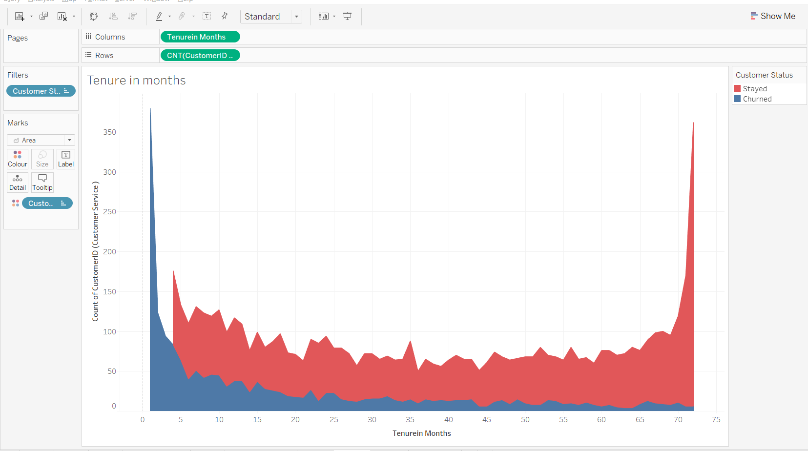
Tenure in Months
The visualization on the right hand side revels the tenure of both the stayed and the churned customers
The blue signifies the churned customers while the red signifies the stayed customers
The tenure of the churned customers drastically decreases after 5 months.
This implies that we should take care of our new joined customers within the first 5 months by giving special offers and proactive customer support

Slide 17
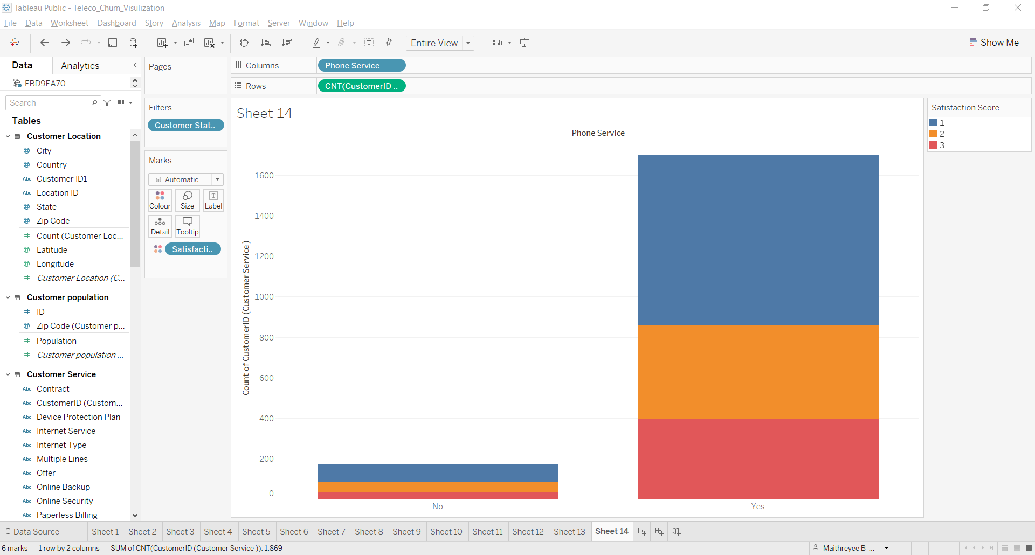
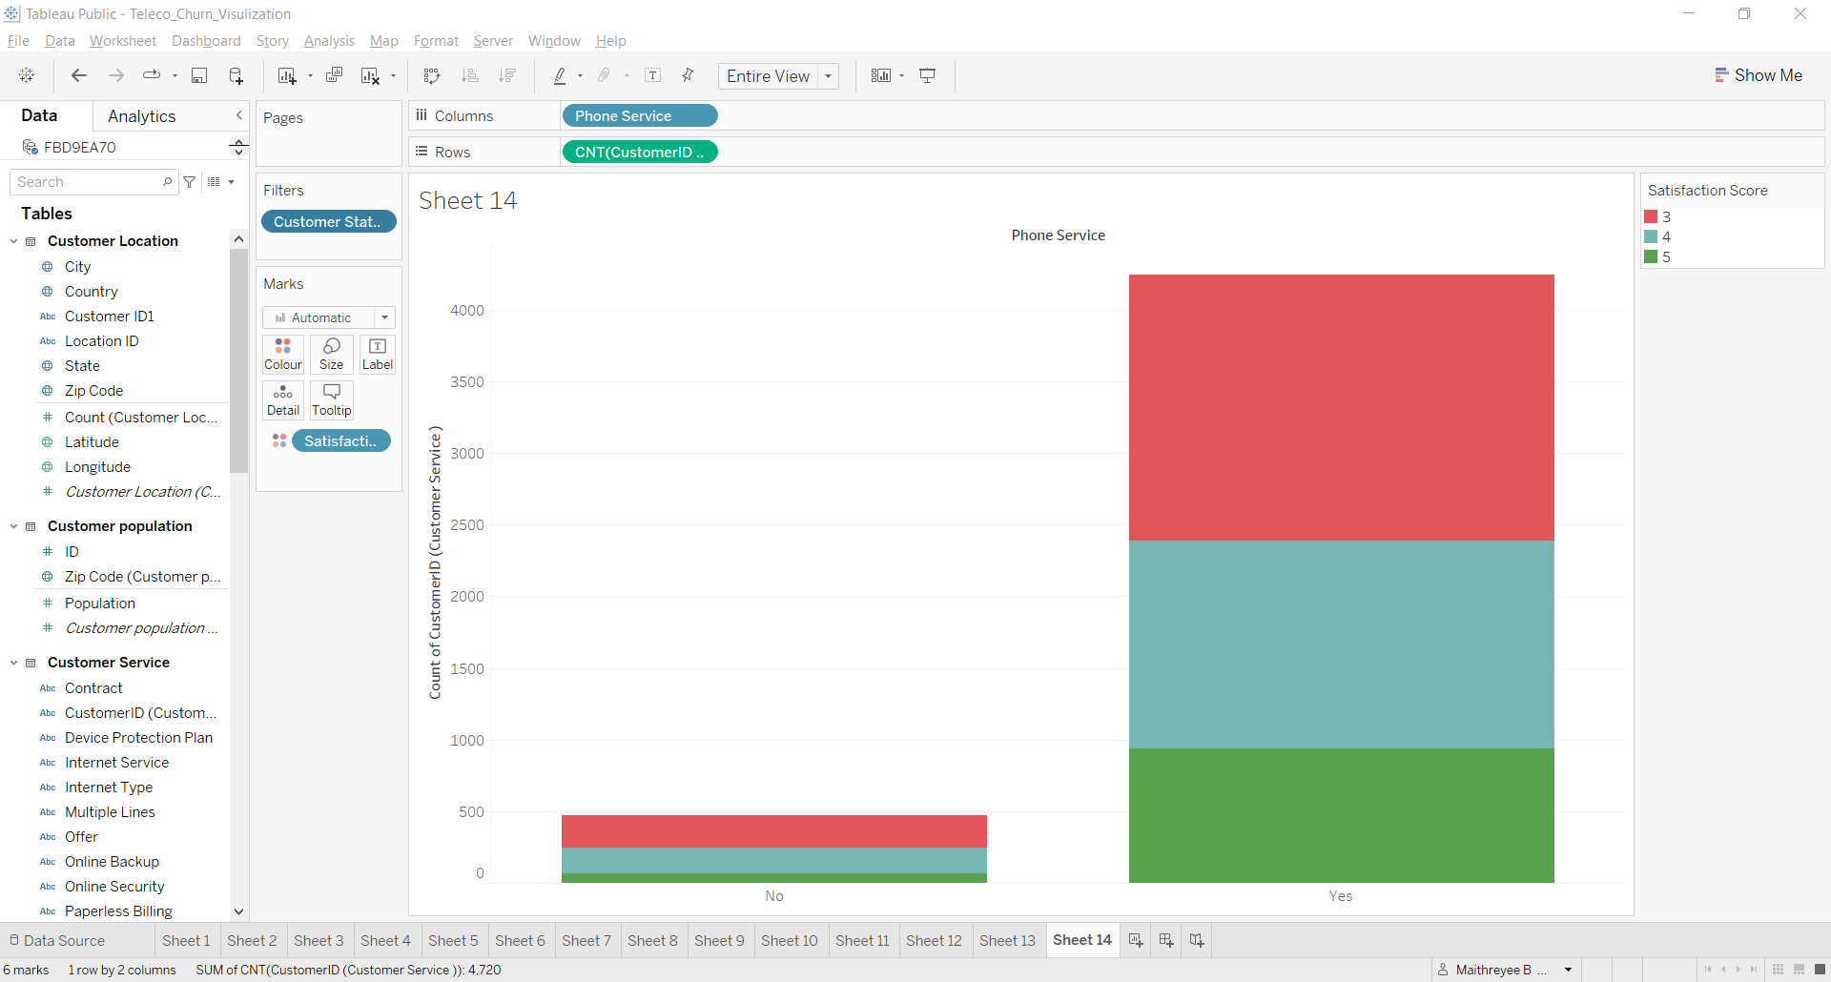
Phone Service
From the graph it is very evident that majority of the customers who have churned have subscribed to phone service as well
This implies that there is some correlation between the internet service and phone service
Most the customers have citied competitor has better devices and product dissatisfaction as major churn reason.
This may imply that customers were using DSL but they were not satisfied with the modems and switched to Fiber optics.
They were not satisfied with our Fiber optics service as well hence they left our company.
Churned Customers
Stayed Customers

Slide 18
How To Avoid Customer Churn
Some ways we can reduce customer churn
Addressing the top churn reason :
Competitor Comparison: Since a good number of customers have left due to competitors offering better devices and prices. An analysis should be done on our products and find ways to improve our products and offer better downloading speeds and prices.
Support Quality: The other most common reason for churn was related to the attitude of the support personal. Investing in customer service training program to improve support quality can reduce churn.
Customer Feedback:
To adopt a systematic method for gathering and analysing customer feedback to better understand their pain points. By tackling issues like network reliability and product dissatisfaction, we can improve customer retention.
Improving Transparency :
A good number of customers cited ‘Don’t Know’ as their churn reason. This indicates a lack of clear communication or understanding od the service issues. Increasing the transparency can ensure customers understand the value and benefits of the services.
Targeting Marketing and Offers:
For reasons related to competitors ,target marketing campaigns that emphasis on unique selling points and special offers might help retain customers who are consider switching

Slide 19
Check the CLTV score:
We can even check for cltv score of our customers. The customers who have a score higher than 65 are likely to churn.
These customers we can ask them for feedback and get their inputs. With these inputs we make the changes. This way we can reduce the cltv score and reduce the number of customers from getting churned
Service Customization:
Offering customizable service packages that address specific customer needs like better downloads/uploads speeds or affordable long-distance chargers ,can attract and retain a diverse customer base.
Proactive Customers Service:
Implementing proactive customer service strategies such as regular check-in and surveys, can help identify and address potential issues before they lead to churn.

Slide 20
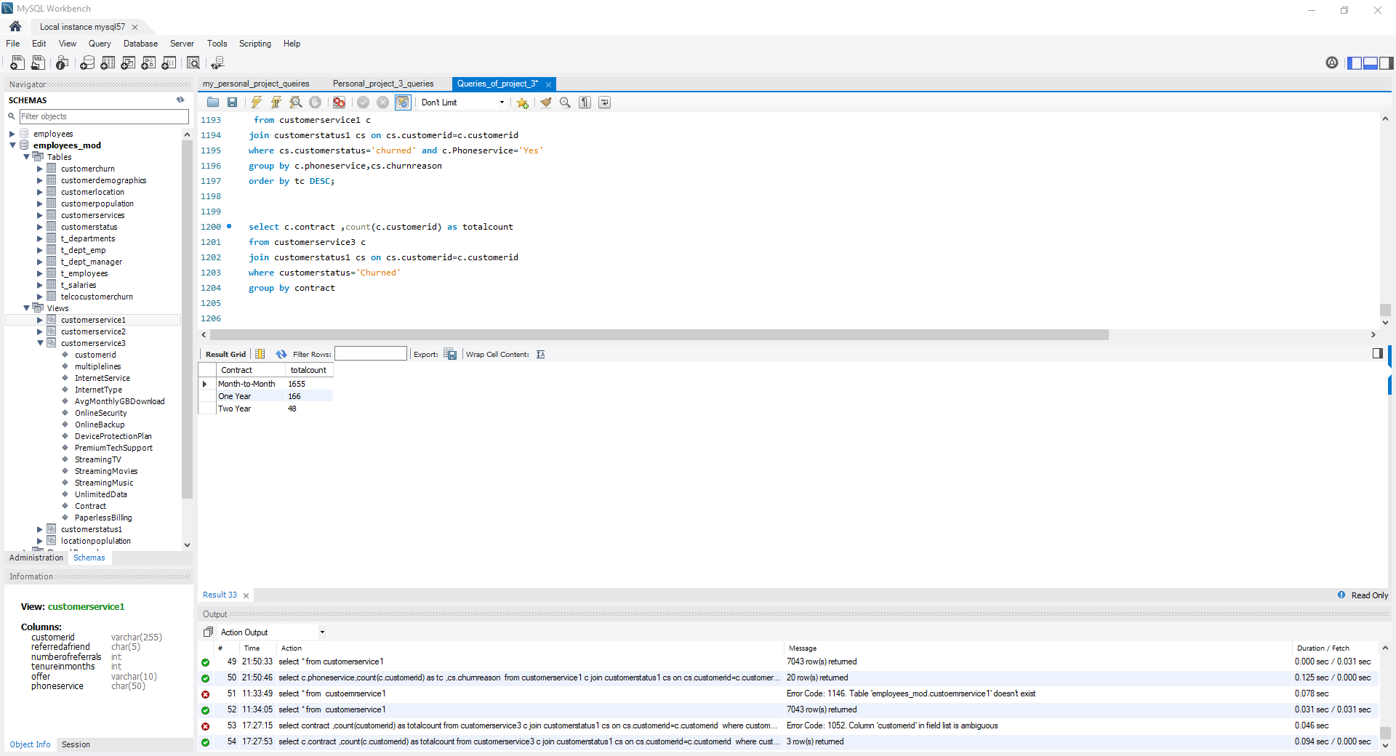
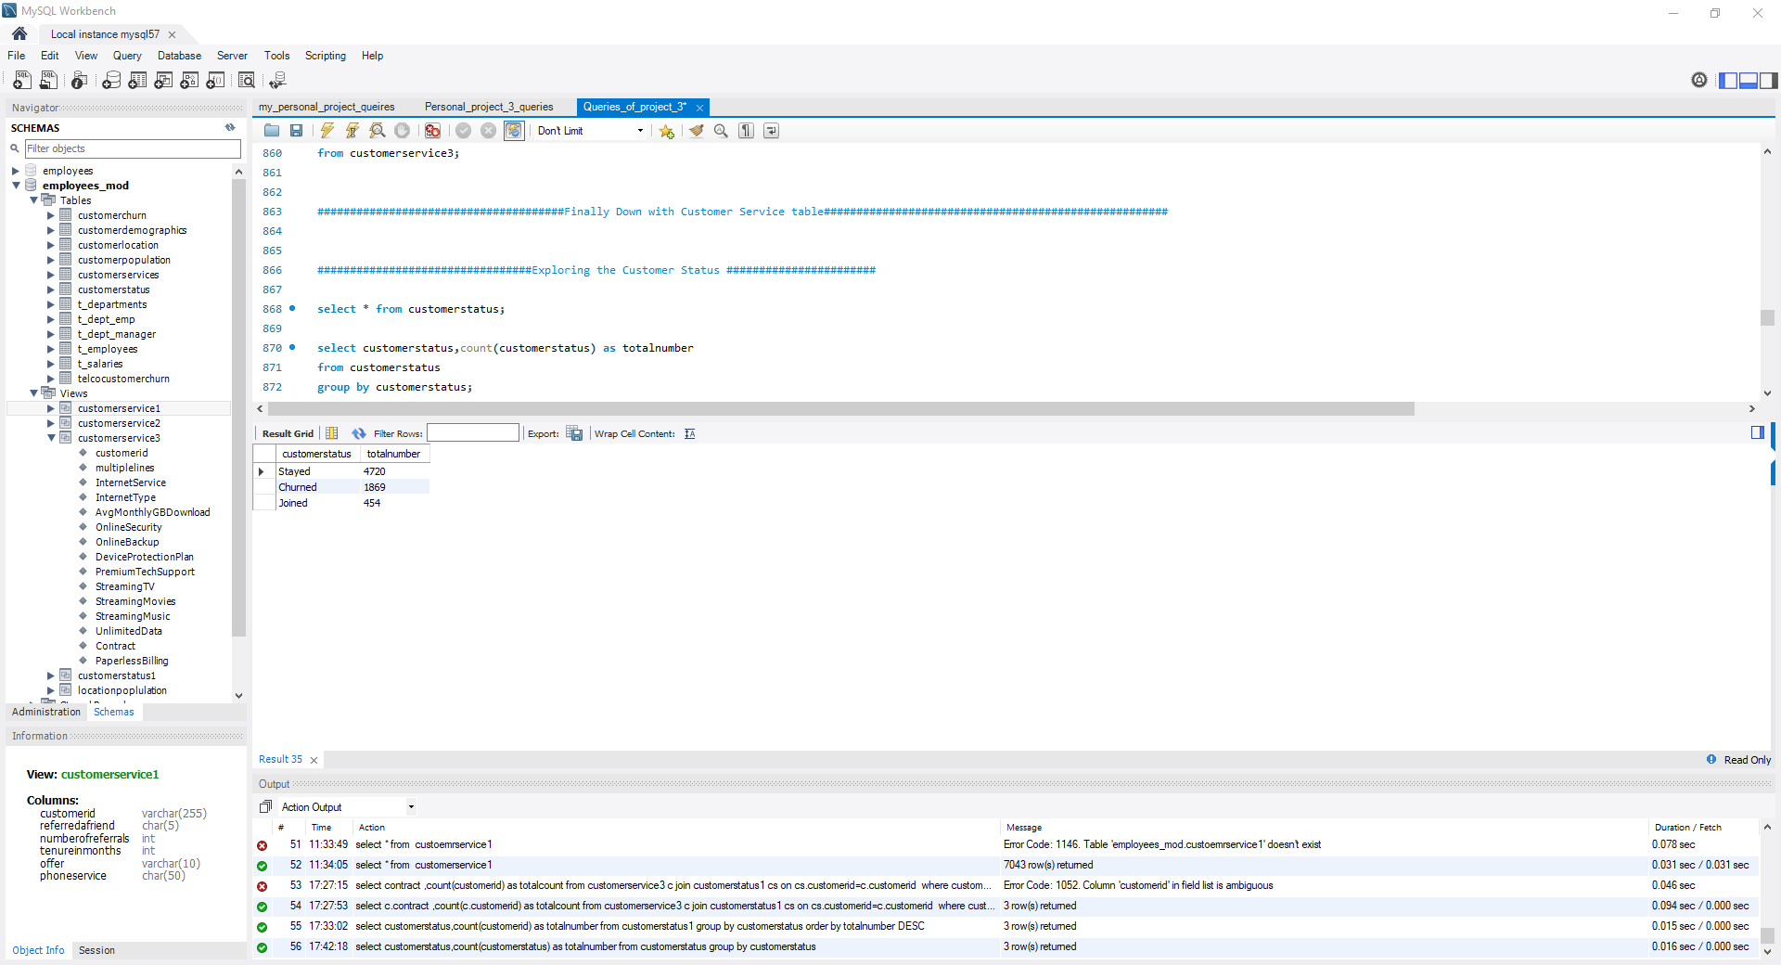
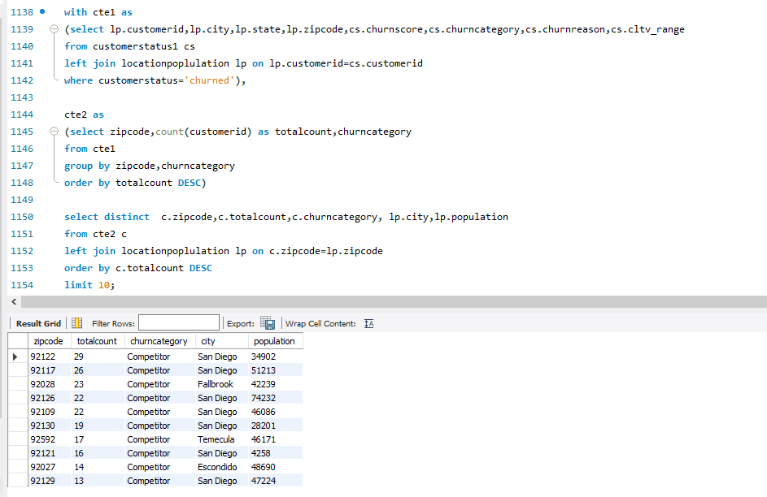
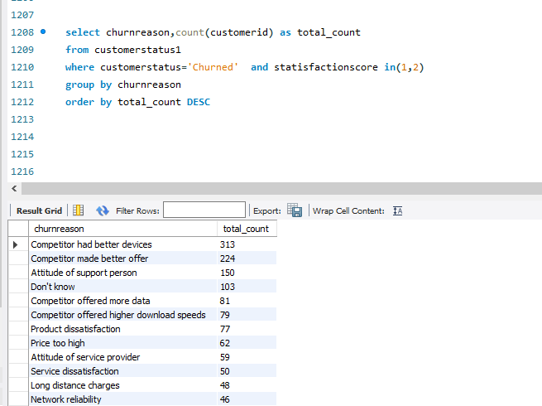
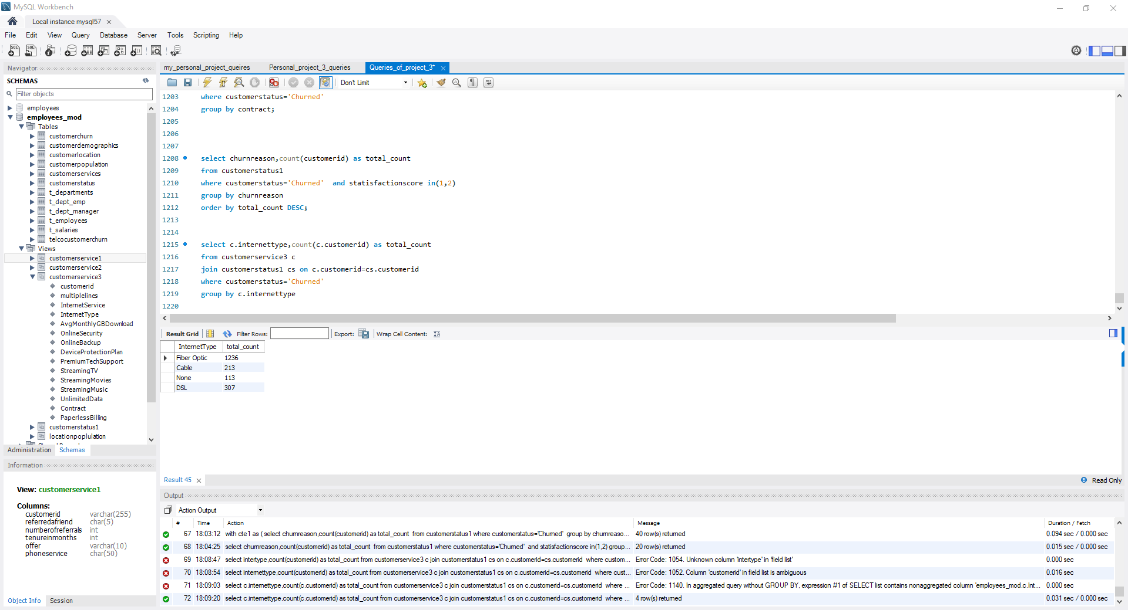
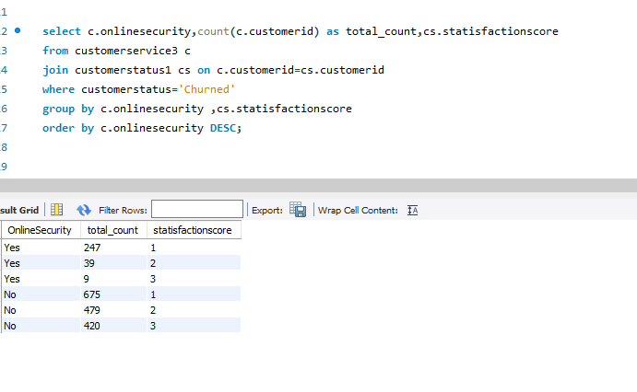
Code Snippets

Slide 21
Thank You

